Slide 1

Customer Shopping Behavior Analysis
Uncovering insights from transactional data for strategic business decisions.

Slide 2
Project Overview & Data Summary
Project Goal
Dataset Snapshot
Analyze 3,900 purchases to optimize operations and guide strategy.
18 columns, 3,900 rows of transactional data.
Demographics (Age, Gender, Location)
Purchase details (Item, Category, Amount)
Behavior (Discount, Reviews, Frequency)
Missing: 37 Review Ratings
Spending patterns
Customer segments
Product preferences
Subscription behavior

Slide 3
Exploratory Data Analysis (Python)
01
02
Data Loading & Exploration
Missing Data Handling
Imported with pandas, checked structure and statistics.
Imputed Review Ratings using median per category.
03
04
Column Standardization
Feature Engineering
Renamed columns to snake_case for clarity.
Created age_group and purchase_frequency_days.
05
06
Data Consistency
Database Integration
Dropped redundant promo_code_used column.
Loaded cleaned data into PostgreSQL for SQL analysis.

Slide 4

SQL Analysis: Key Business Insights
Revenue by Gender
Male customers generated $157,890, Female $75,191.
High-Spending Discount Users
Identified 839 customers who used discounts but spent above average.
Top 5 Products by Rating
Gloves (3.86), Sandals (3.84), Boots (3.82), Hat (3.80), Skirt (3.78).

Slide 5
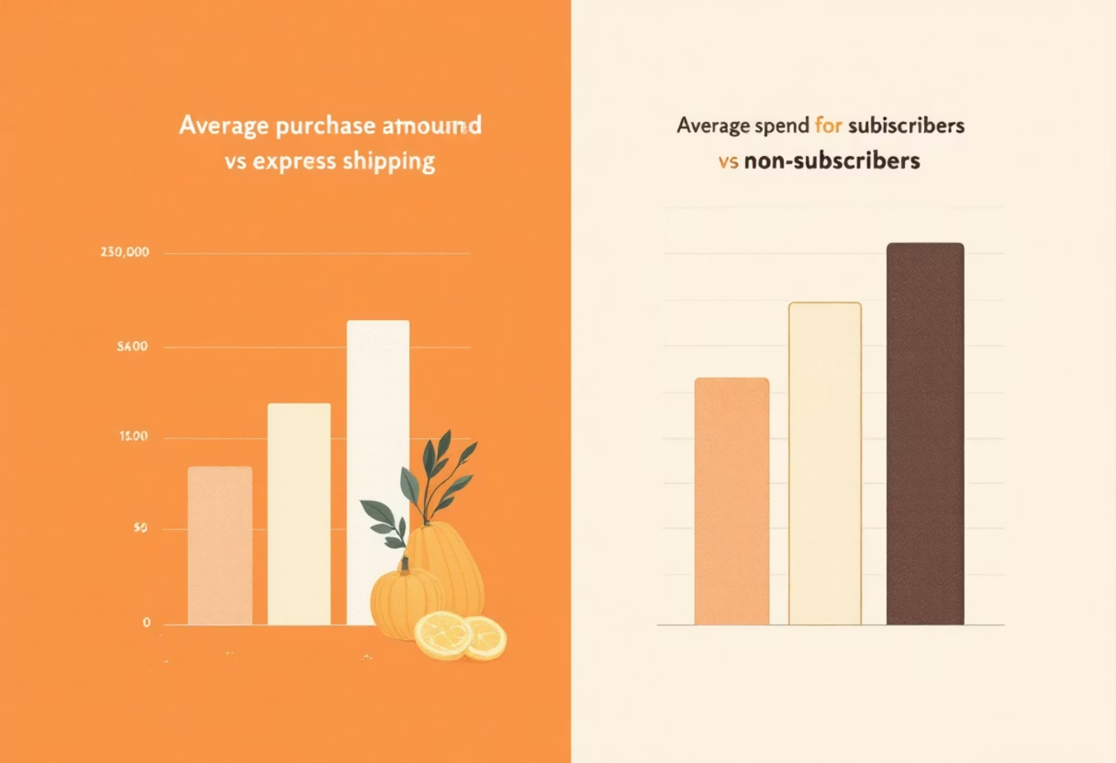
SQL Analysis: Shipping & Subscriptions
Shipping Type Comparison
Express shipping: $60.48 avg purchase. Standard: $58.46 avg purchase.
Subscribers vs. Non-Subscribers
Subscribers (1053) avg spend $59.49, total revenue $62,645.
Non-subscribers (2847) avg spend $59.87, total revenue $170,436.

Slide 6
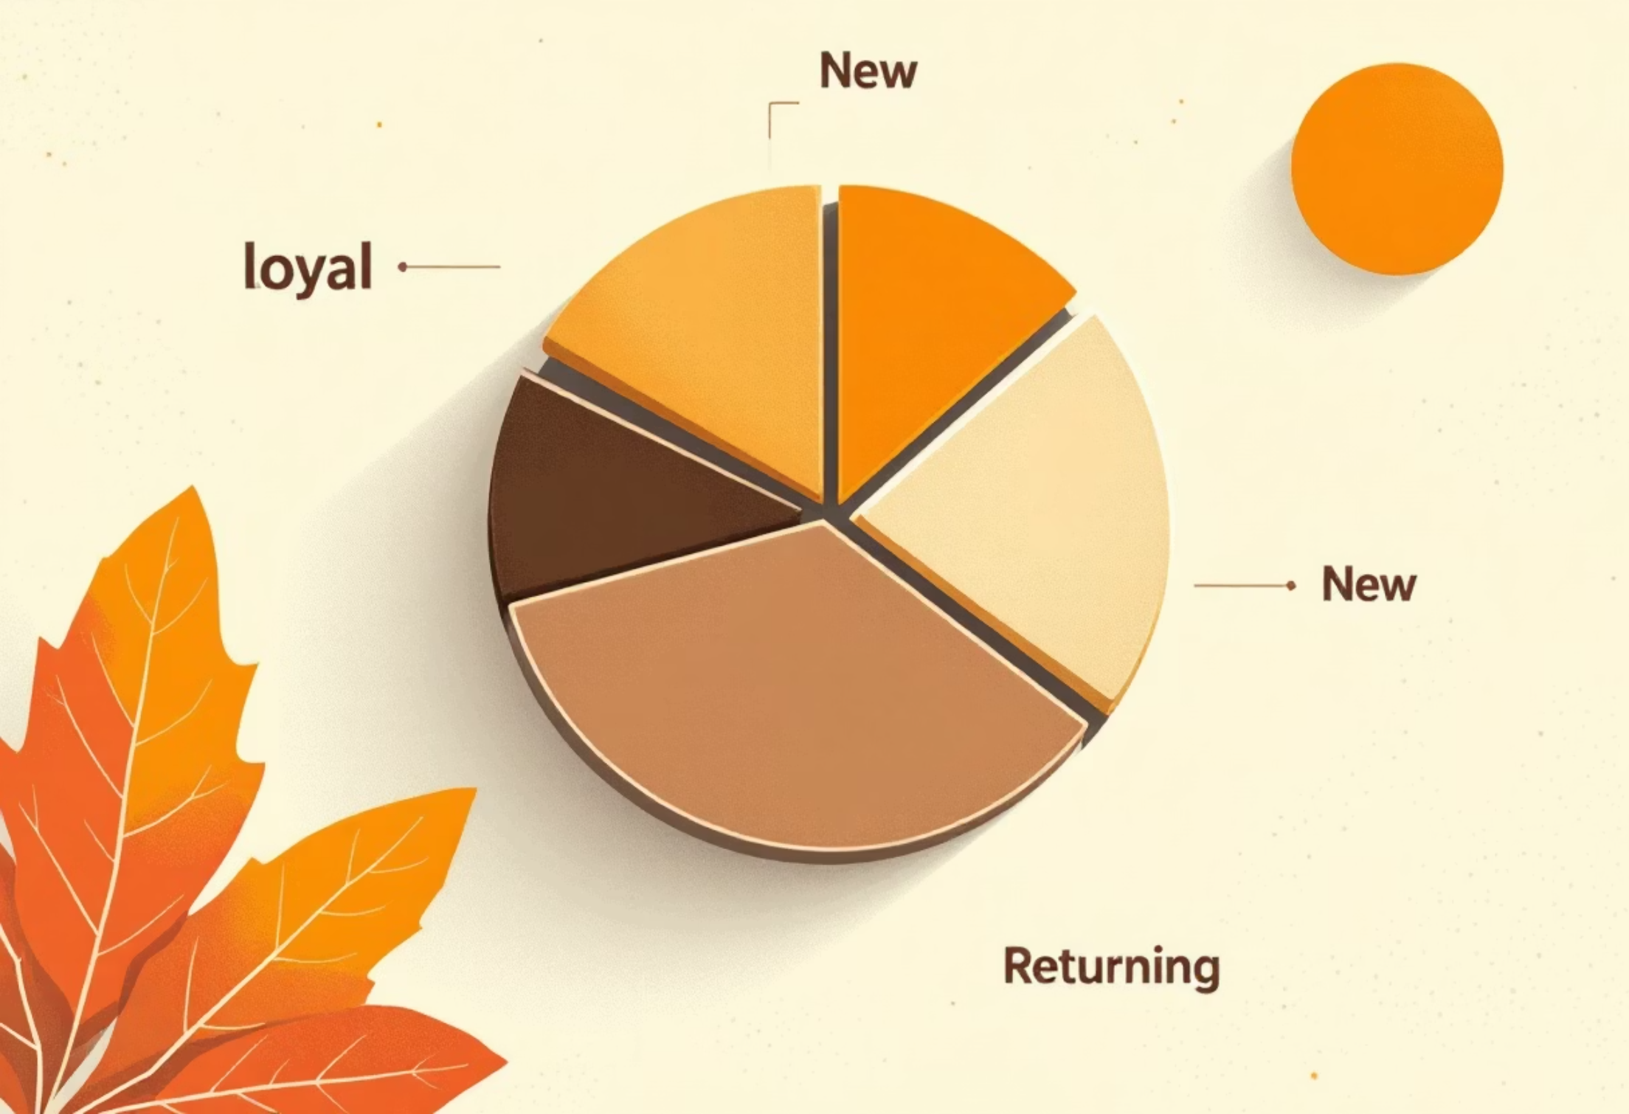
SQL Analysis: Product & Customer Focus
Discount-Dependent Products
Top 5 with highest discounted purchases: Hat (50%), Sneakers (49.66%), Coat (49.07%), Sweater (48.17%), Pants (47.37%).
Customer Segmentation
Loyal (3116), Returning (701), New (83).
Repeat Buyers & Subscriptions
958 repeat buyers are subscribers, 2518 are not.

Slide 7
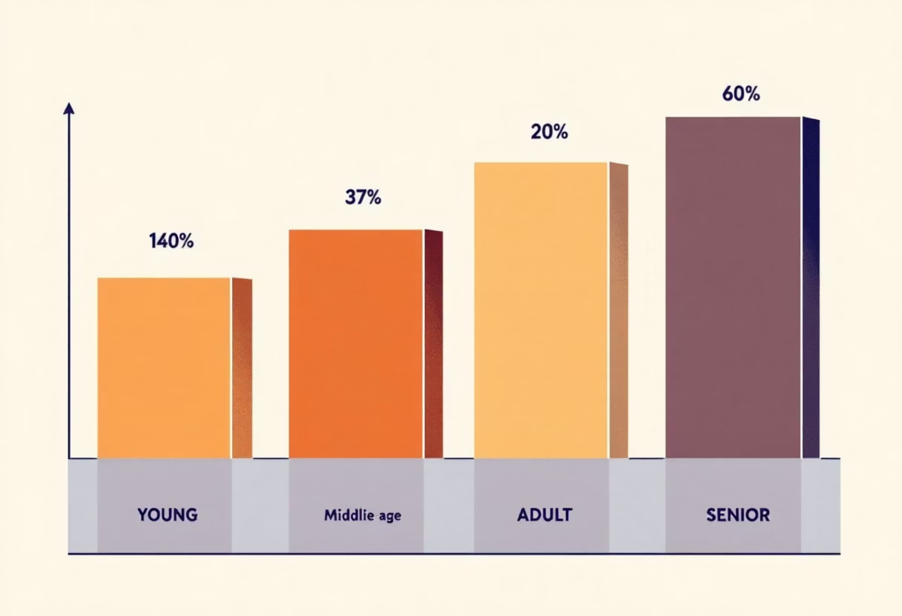
SQL Analysis: Top Products & Revenue by Age
Top 3 Products per Category
Accessories: Jewelry, Sunglasses, Belt
Clothing: Blouse, Pants, Shirt
Footwear: Sandals, Shoes, Sneakers
Outerwear: Jacket, Coat
Revenue by Age Group
Young Adult: $62,143
Middle-aged: $59,197
Adult: $55,978
Senior: $55,763

Slide 8

Power BI Dashboard: Visual Insights
Interactive dashboard for visual presentation of key metrics and trends.

Slide 9
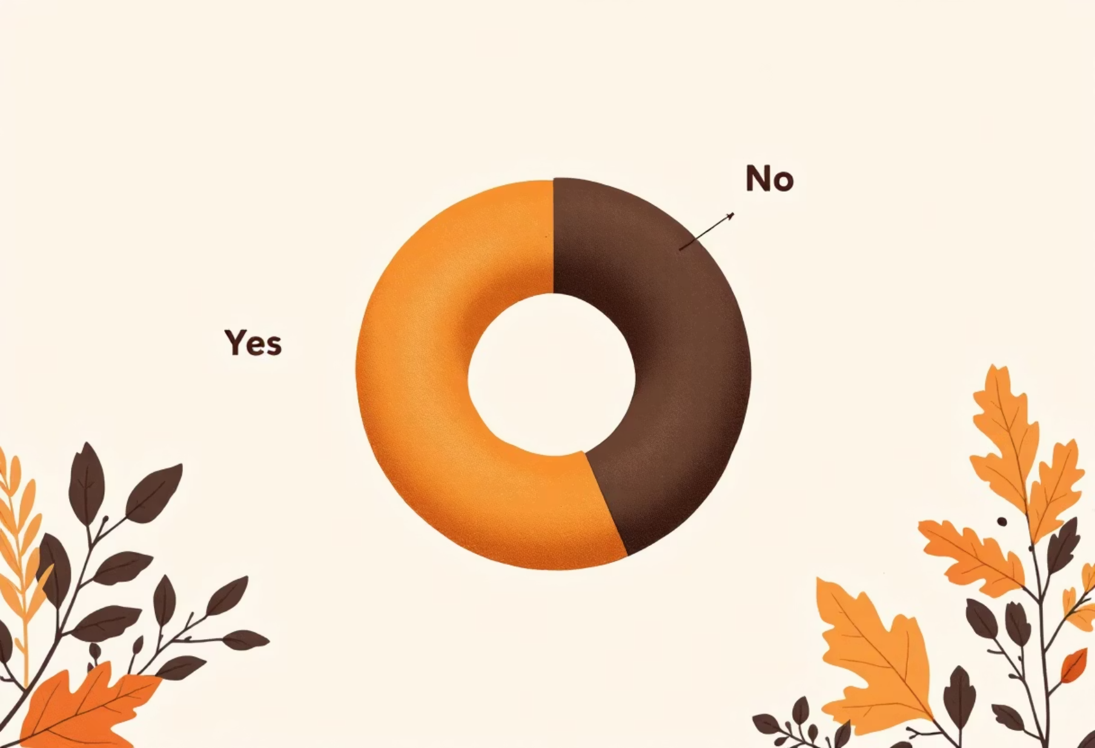
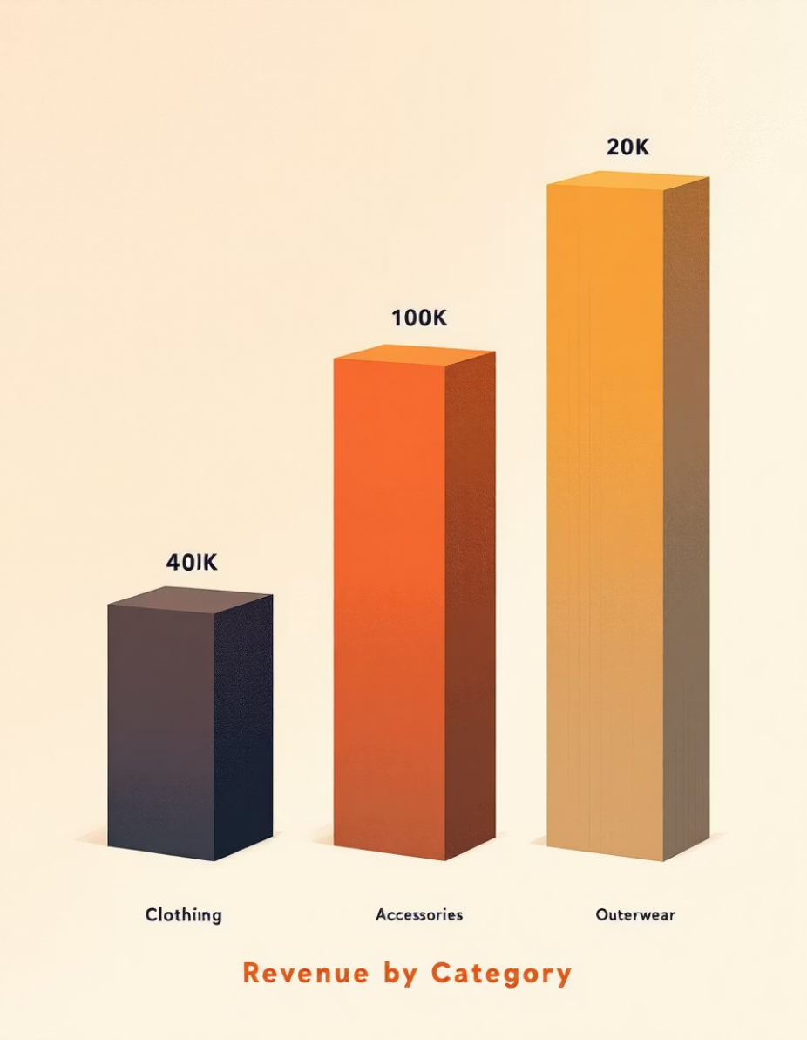
Key Dashboard Metrics
3.9K
$59.76
3.75
Customers
Avg. Purchase
Avg. Review Rating
Subscription Status
Revenue by Category

Slide 10
Business Recommendations
Boost Subscriptions
Customer Loyalty
Review Discount Policy
Promote exclusive benefits to increase subscriber base.
Implement programs to reward repeat buyers and foster loyalty.
Balance sales boosts with margin control for profitability.
Product Positioning
Targeted Marketing
Highlight top-rated and best-selling products in marketing campaigns.
Focus efforts on high-revenue age groups and express-shipping users.

